Slide 1
Watch Me Whip
Group 2

Slide 2
About the website
Watch Me Whip is an online watch shop that allows users to view/buy luxury, dress, casual, digital watches

Slide 3
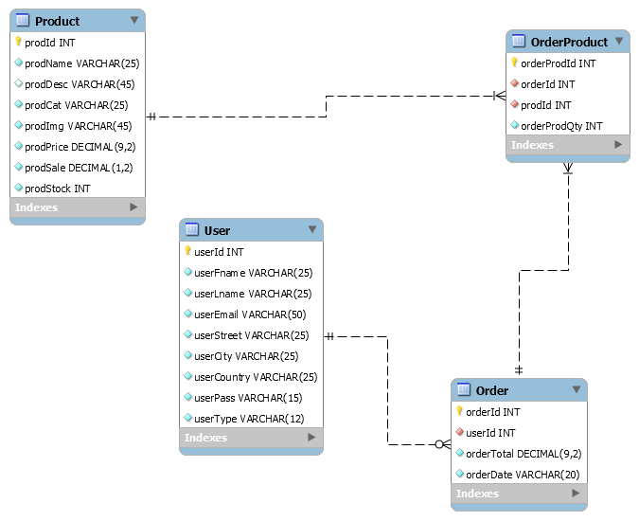
Entity Relationship Diagram

Slide 4
Distribution of Work
Client-Side
Lance Jasper Lopez
Danna Soquiat
Meynard Denoyo
Server-Side
Ziegfreid Morissey Flameño
Kassandra Ysabel Fuentes
William Kalingasan

Slide 5
Watch Me Whip
Login
Register
Browse Products
- Per Category
Add to Cart
Checkout

Slide 6
Servlets
Add To Cart Servlet
Category Count Servlet
Checkout Servlet
Product Servlet
Show Cart Servlet
Login Servlet
Register Servlet
Edit Servlet
Delete Servlet
Safe Servlet

Slide 7
Listener
User Listener
Filter
Blacklist Filter
Register Filter

Slide 8
Scope
Use JSP, Servlet, Java Bean, JDBC and Oracle. (Additionally used Ajax and Angular JS)
Register, Log in, select to cart, buy and check the order
Filter to prevent the black user lists (“John”, “Scott”) to log in
Cash on delivery
E-R model

Slide 9
Limitation
No Logout
No Cart Editing
Need User Login First before shopping
Minimal Validations
No non-unique indexes (only unique)
Minimal Servlet Reponses (No dedicated UI for failed login, banned login, confirm purchase)
No User Indicator
No Custom Quantity
No Junit Testing
No Order History
No Admin Functions

